Slide 1
Friends of the River Eden Ecosystem Because we are all part of it
An Introduction
Notes:
Thank you for inviting us to speak today about Friends of the River Eden Ecosystem – because we are all part of it.
Our introduction slides will take around 15-20 minutes, after which we’ll be happy to take any questions.

Slide 2
What we’ll cover
FREE – the why, what and the how
The challenge
How we might work together
Q&A
Notes:
The why, what and how:
A closer connection to nature can bring many benefits - it is in our interests to look after it better.
We are more likely to care for something we know – and we are extremely fortunate to have so much nature, including the River Eden on our doorstep, just waiting to be explored.
So, let’s start to explore…

Slide 3
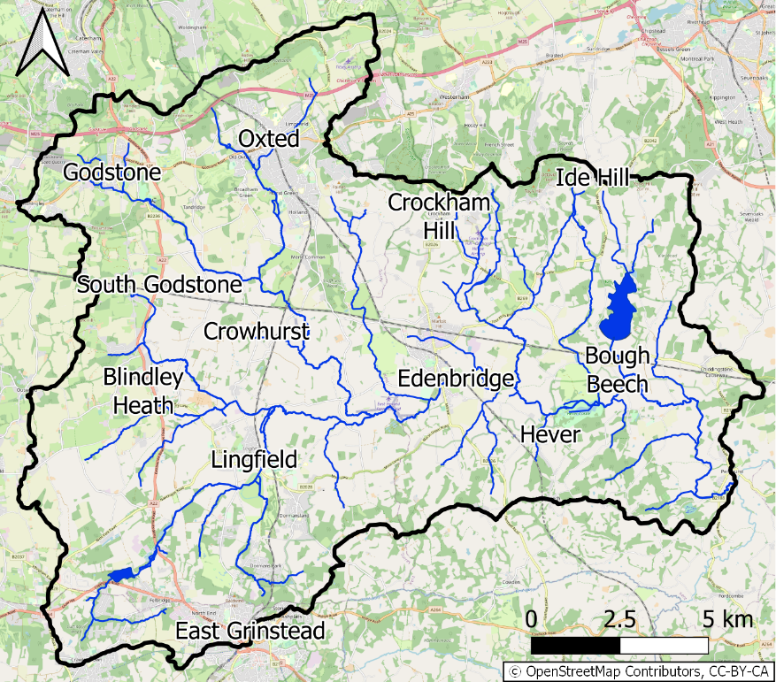
Catchment Area
… is bigger and much more complex than we first thought!
Notes:
Large, complex catchment area
The River Eden is a tributary of the River Medway, joining it at Penshurst
FREE is part of the Medway Catchment Partnership, looking after the Upper River Eden
We are building a network of volunteers in Hurst Green groups up and downstream including Limpsfield, Oxted, Lingfield and Edenbridge.

Slide 4
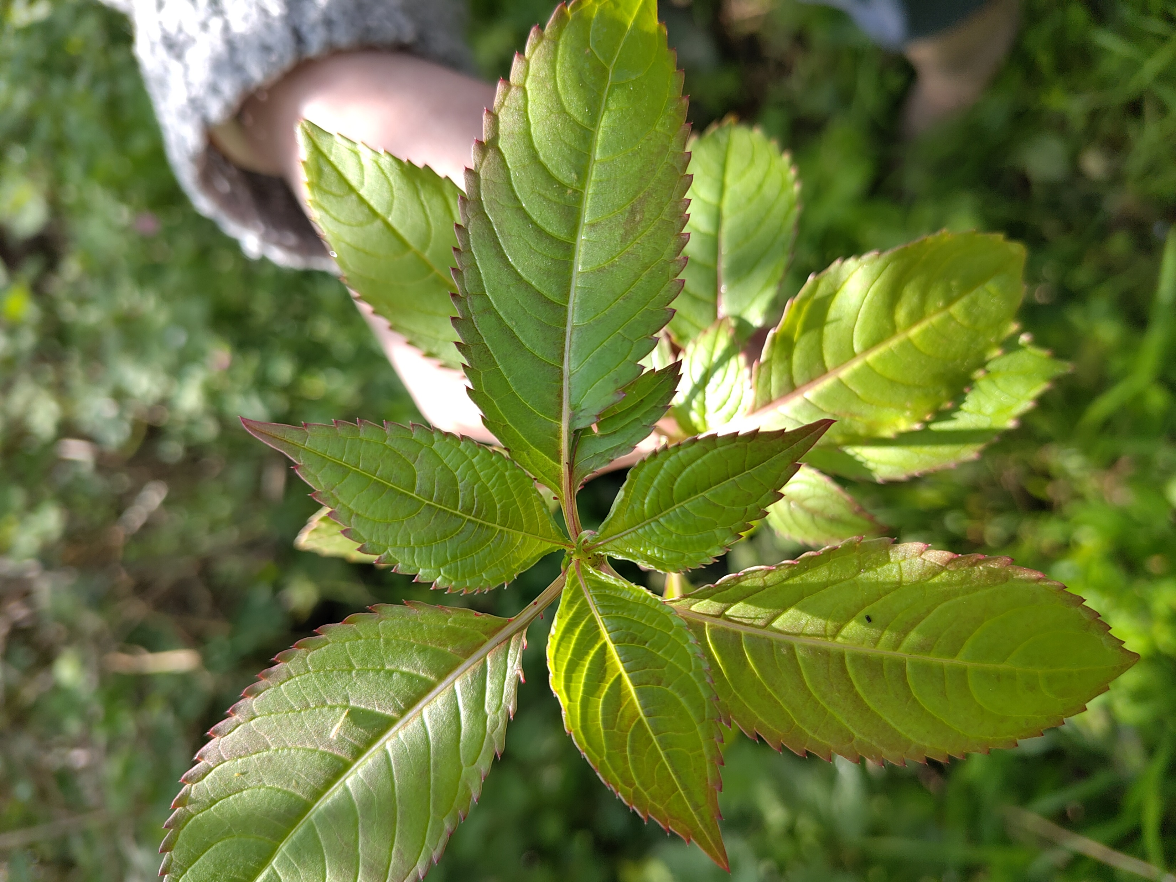
Environment Agency Designation - poor
Agricultural pesticide, herbicide and fertiliser run-off
Storm overflows – untreated wastewater
Limited fish access – weirs, flood defences etc
Invasive Non-Native Species (INNS) e.g. Himalayan Balsam
Litter, particularly plastics
Notes:
Why does the River Eden need friends?
Biodiversity is reduced by poor water quality caused by pesticide, herbicide and fertiliser run-off from farms …
… and what enters the wastewater treatment system e.g. what we put down our drains, what runs off our roads and gardens
The southeast has some of the most engineered water courses in the UK, making it difficult for fish and other wildlife to thrive.
We have Invasive Non-Native species such as Himalayan Balsam that crowds out other plants and destabilises riverbanks, and litter. Fortunately, these are things we as individuals and local groups can do something about.

Slide 5
The good news
Local people care: 60+ volunteers
Supportive landowners e.g. Stonehall Farm, Coltsford Mill, cellXion (Oxted Mill), homeowners with river-side gardens
Partners: Southeast Rivers Trust, Surrey Wildlife Trust, SES Water, Southern Water, Environment Agency, local government
Water quality testing programme established with NEDRA
Organised walks attracted 40+ residents
Himalayan Balsam Bashes
Kingfisher spotted near Moor House School
Roach and Chub found near Coltsford Mill
FREE providing input to Surrey’s Local Nature Recovery Strategy
Notes:
Go through slide

Slide 6
Why do people care?
Fond memories: playing in the River Eden, river jumping, seeing fish and kingfishers – wanting that for their own children and grandchildren
Wanting to do something about the serious biodiversity loss in the UK, and especially in Surrey
Rising awareness of the poor state of the UK’s rivers and the causes of pollution
Realising that we can’t leave it to “someone else” or “the powers that be”
Pride in our local area – wanting to look after it better
Notes:
Helen, a Hurst Green resident said:
Getting on and actually doing something just feels right. To me, rivers are romantic, beautiful and the nature’s network bringing so much to our lives; walking alongside the flowing water is a wonderful experience. The river is not conspicuous in our area: it runs through gardens, fields and woodland and appears every now and then for all to see, but is mostly hidden unless you know where to find it.
Peter from Edenbridge adds:
We have the Eden at the bottom of our garden and have become aware over the last few years how much life has disappeared from the river since we moved in 30 years ago and especially in the last 5 years. We appear to have reached some sort of tipping point where aquatic life can't take the increased levels of pollution.

Slide 7
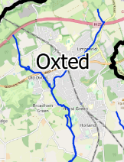
IT’s a huge challenge!
Our focus 2024-25:
Local resident engagement
Stretch from 1, Woodhurst to Jincox Farm
Himalayan Balsam Bashing
Water Quality Testing
Landowner engagement
Strengthening the network
Notes:
FREE is a small group run by volunteers.
We need to focus our efforts, so for 2024-25 we will concentrate on…
Let’s tackle it together!

Slide 8
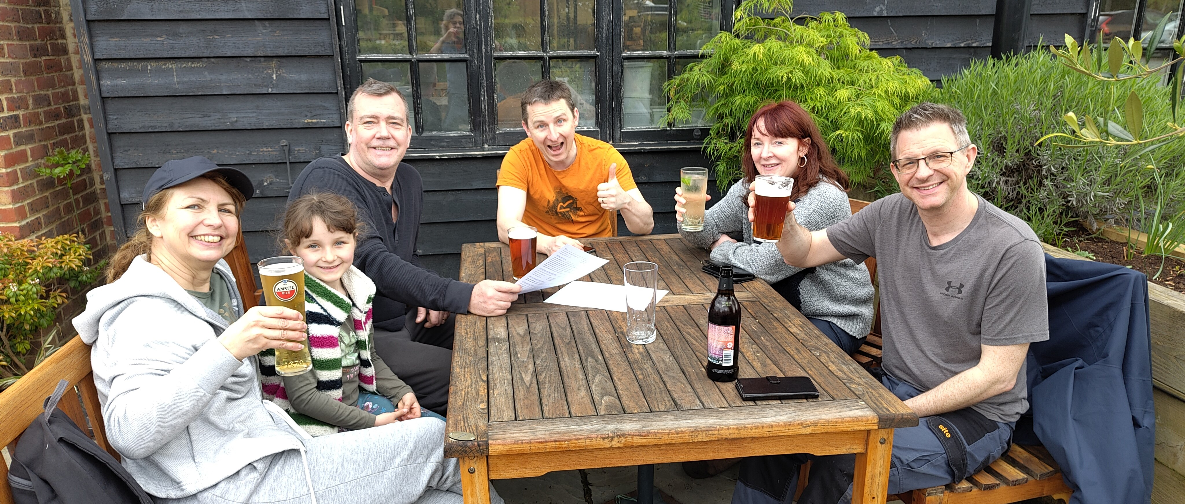
Let’s tackle it together!
Notes:
FREE is about taking action, learning and having fun!

Slide 9
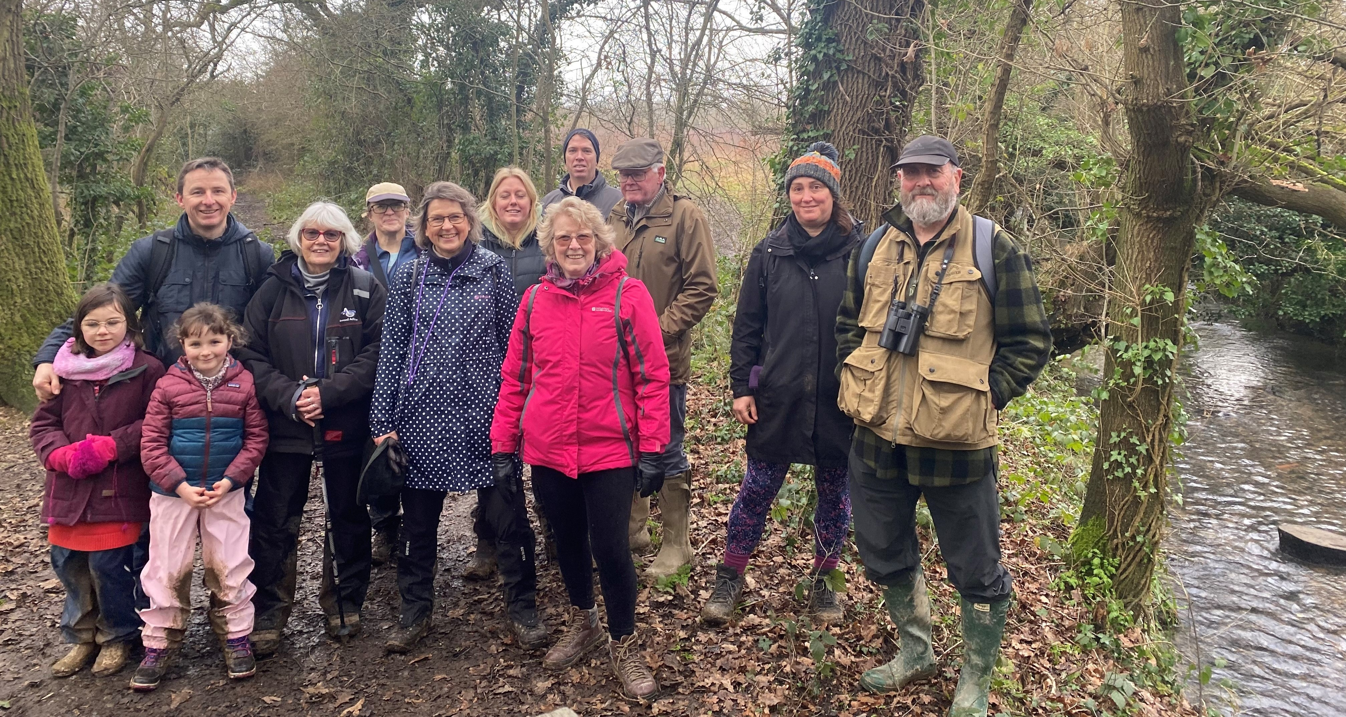
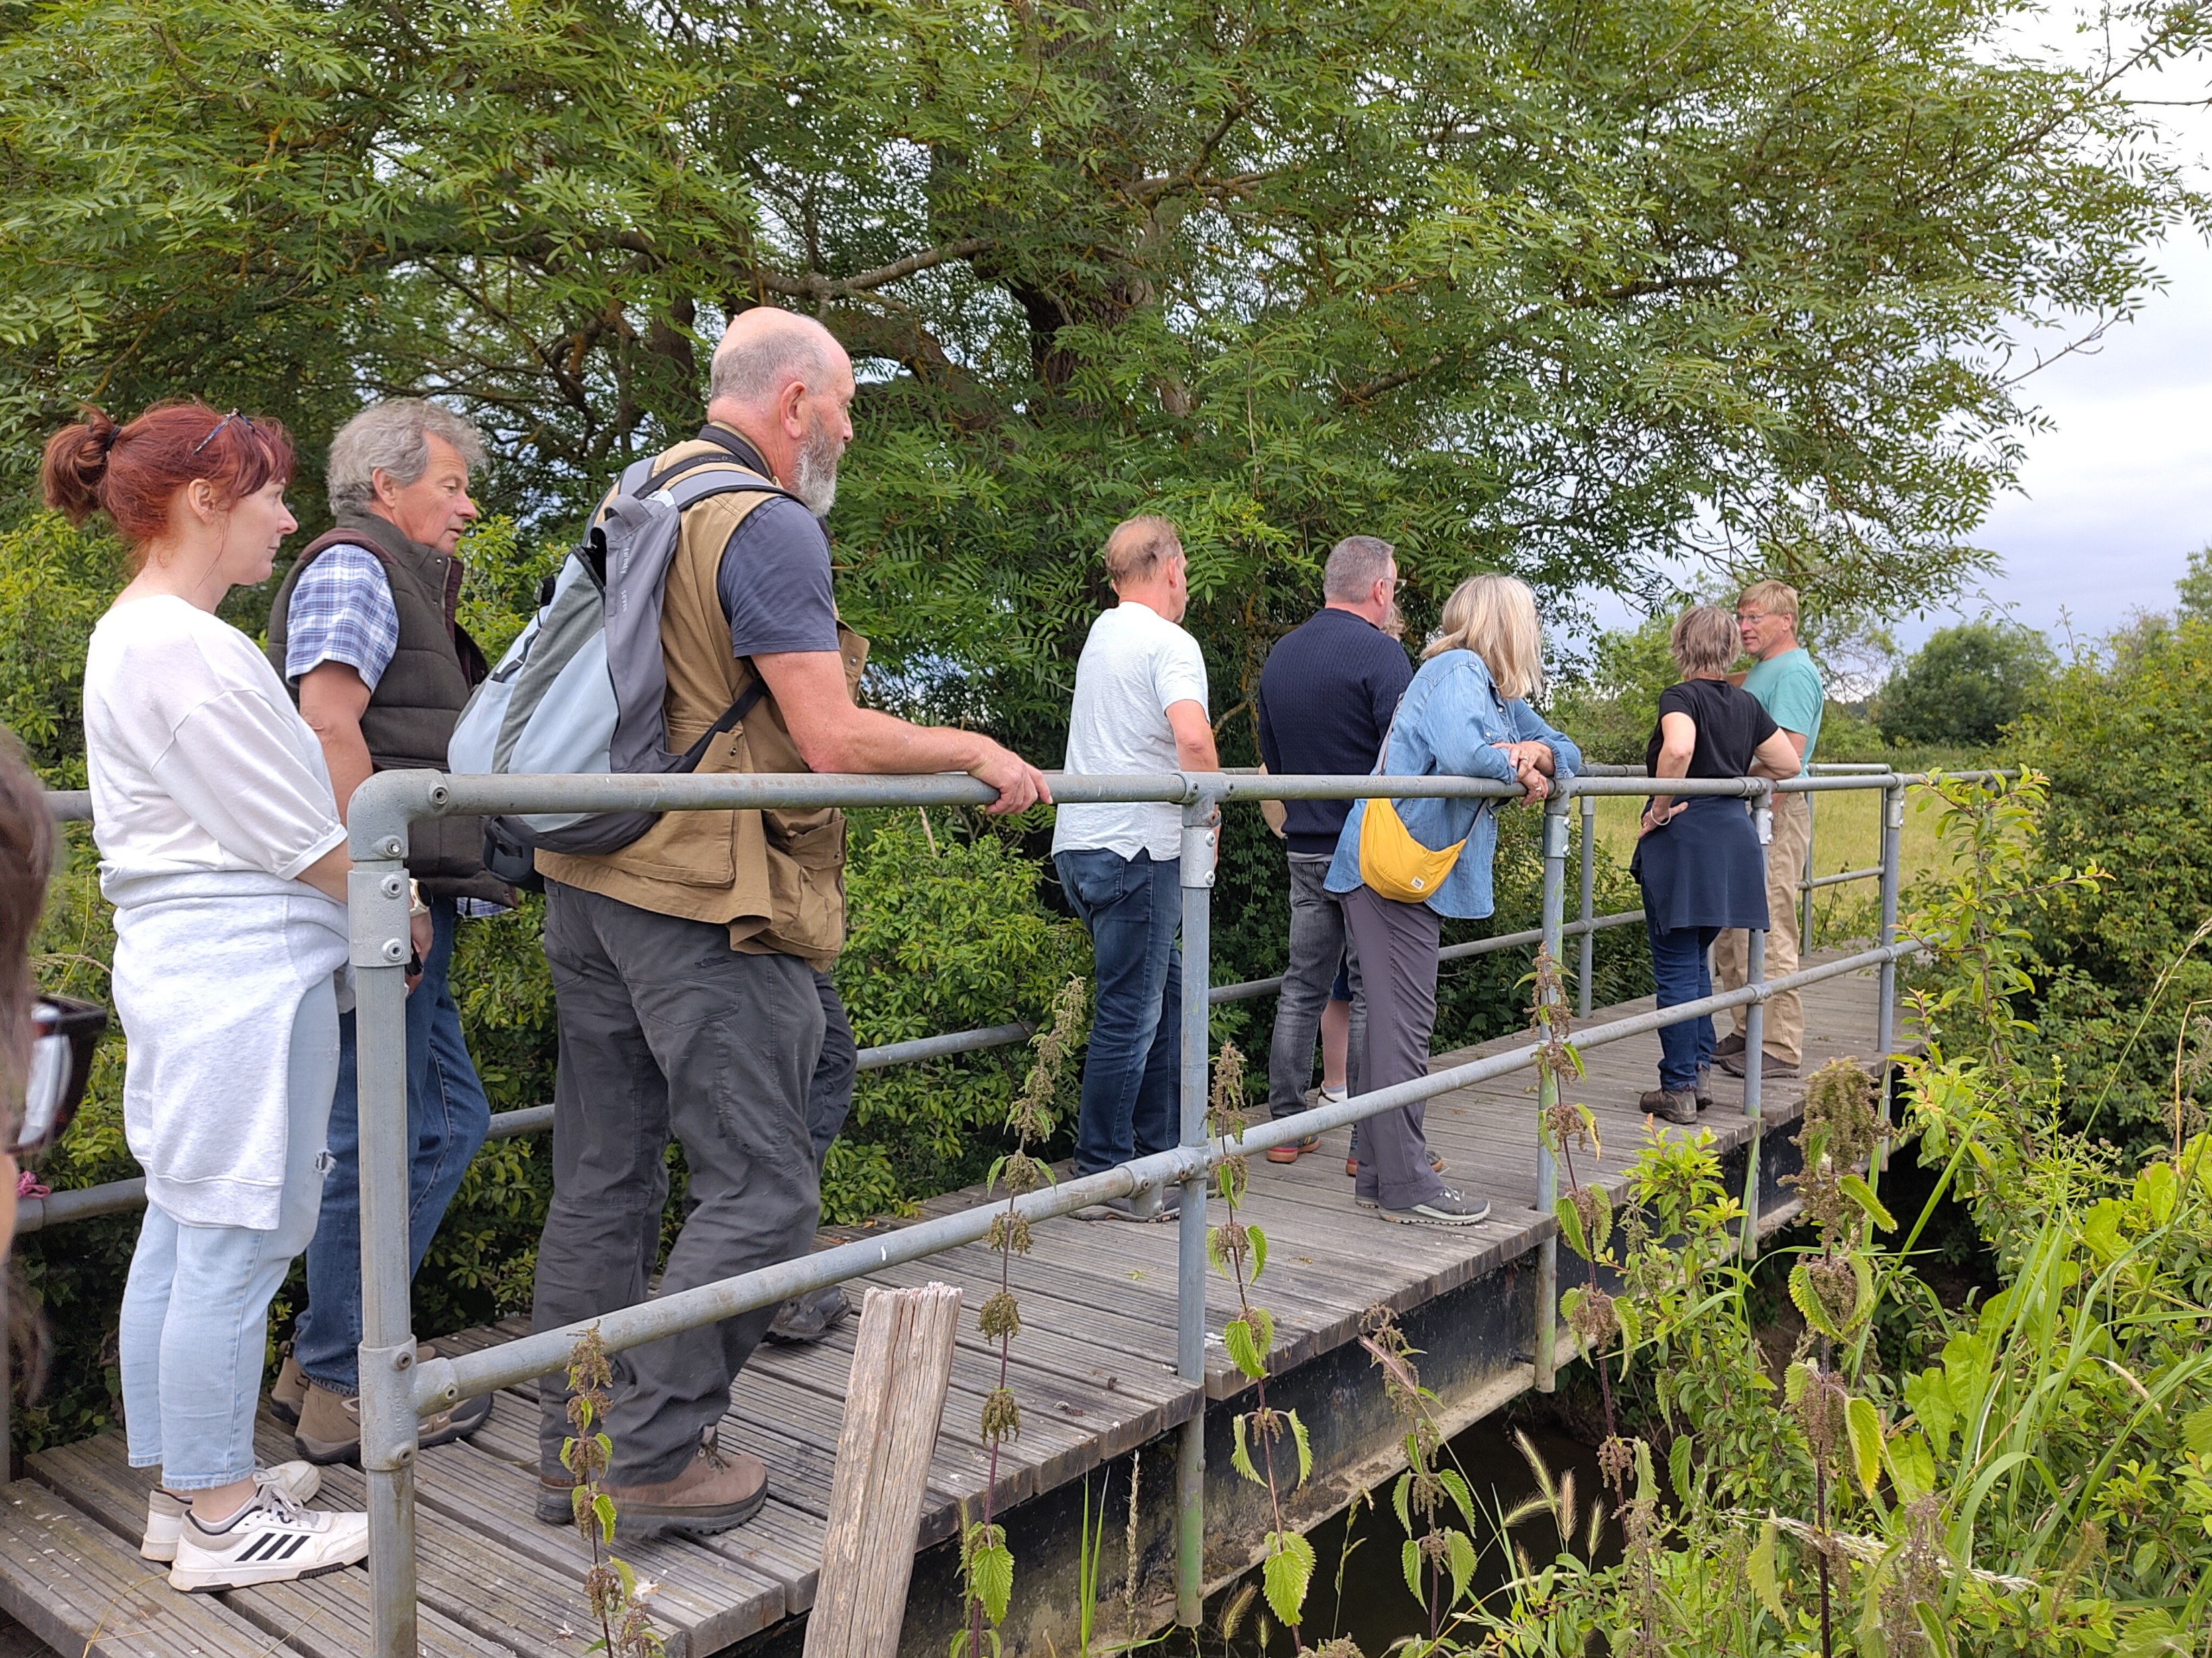
Be curious, find out…
Notes:
Come on our walks and to our talks to learn more about our River and its ecosystem
Join SERT and SWT who have loads of information, ideas and activities to volunteer for on their websites and in their newsletters

Slide 10
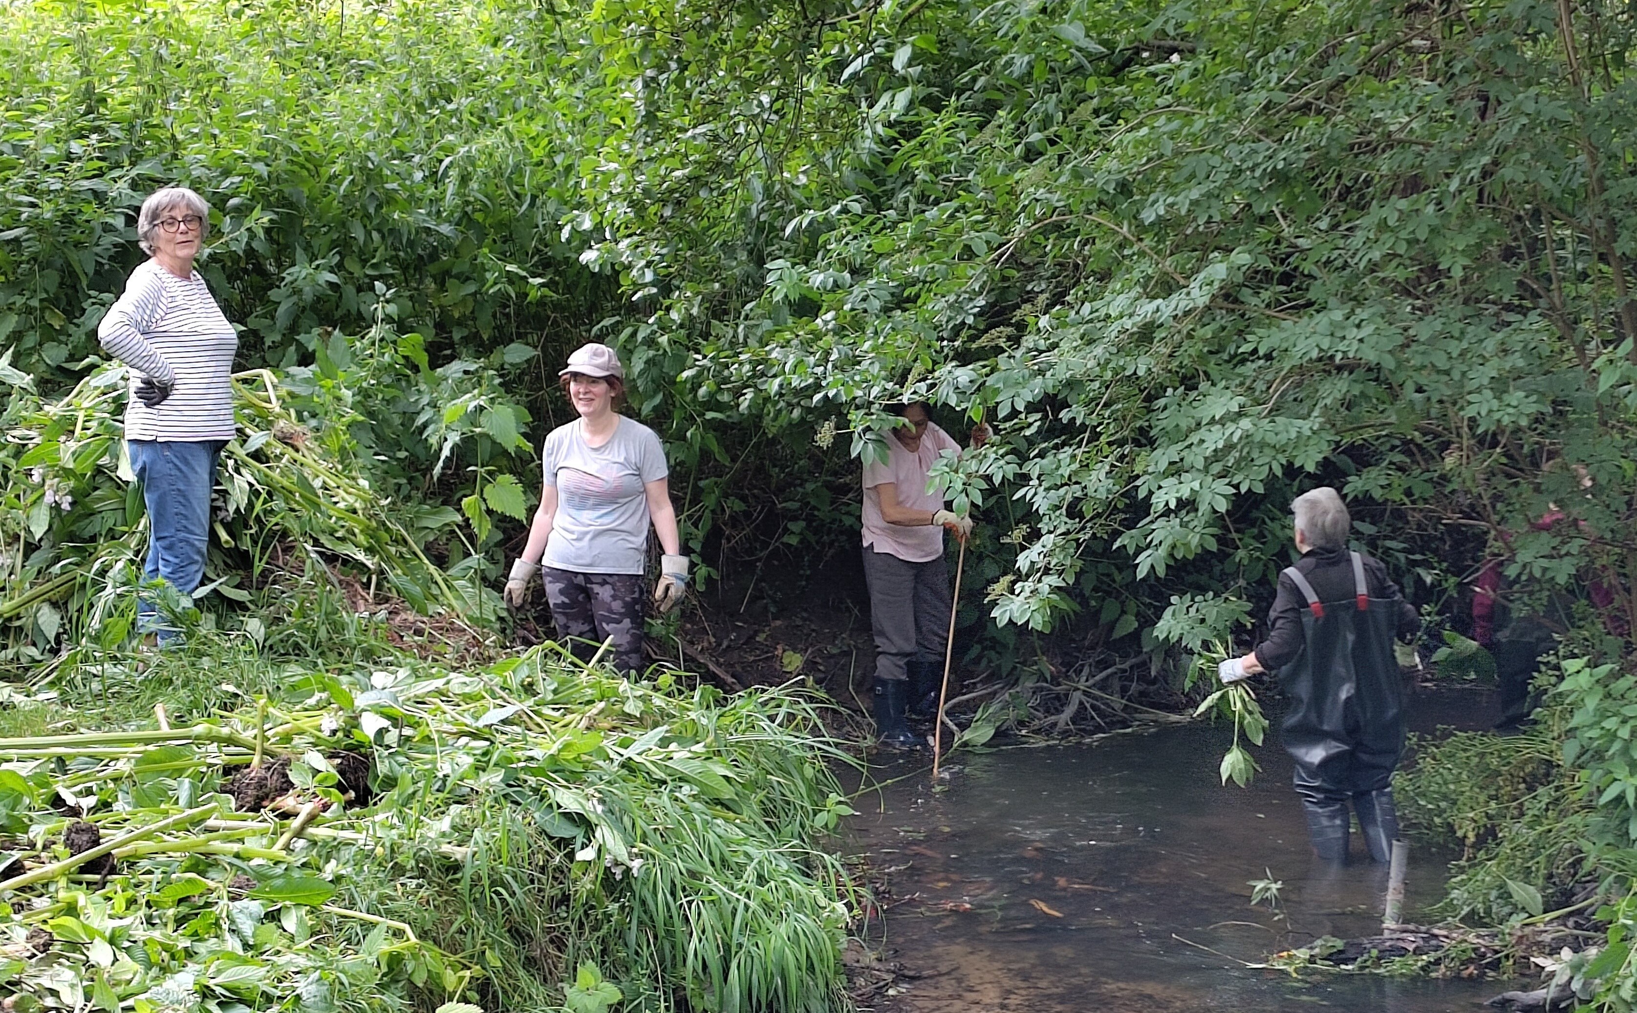
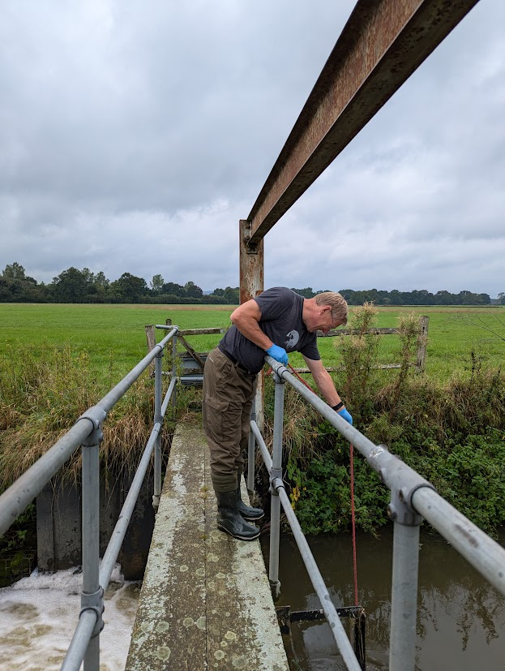
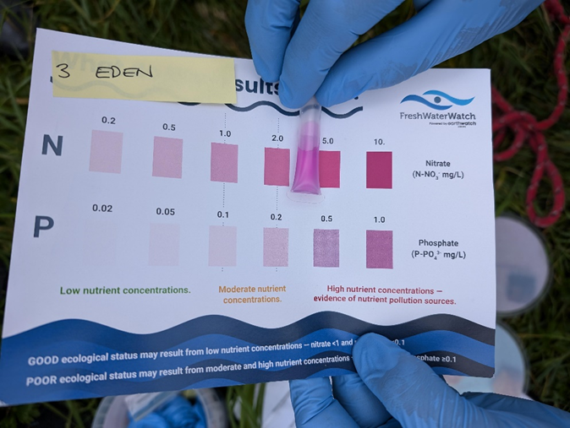
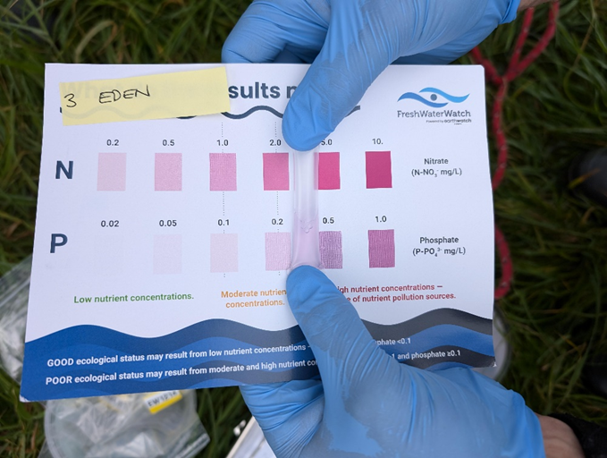
Volunteer!
Notes:
Taker part in activities such as:
Controlling Invasive Non-Native Species and
Mapping invasive non-native species on the INNS app
Monitoring water quality to provide information to local people and evidence for campaigns
Earthwatch.org.uk

Slide 11
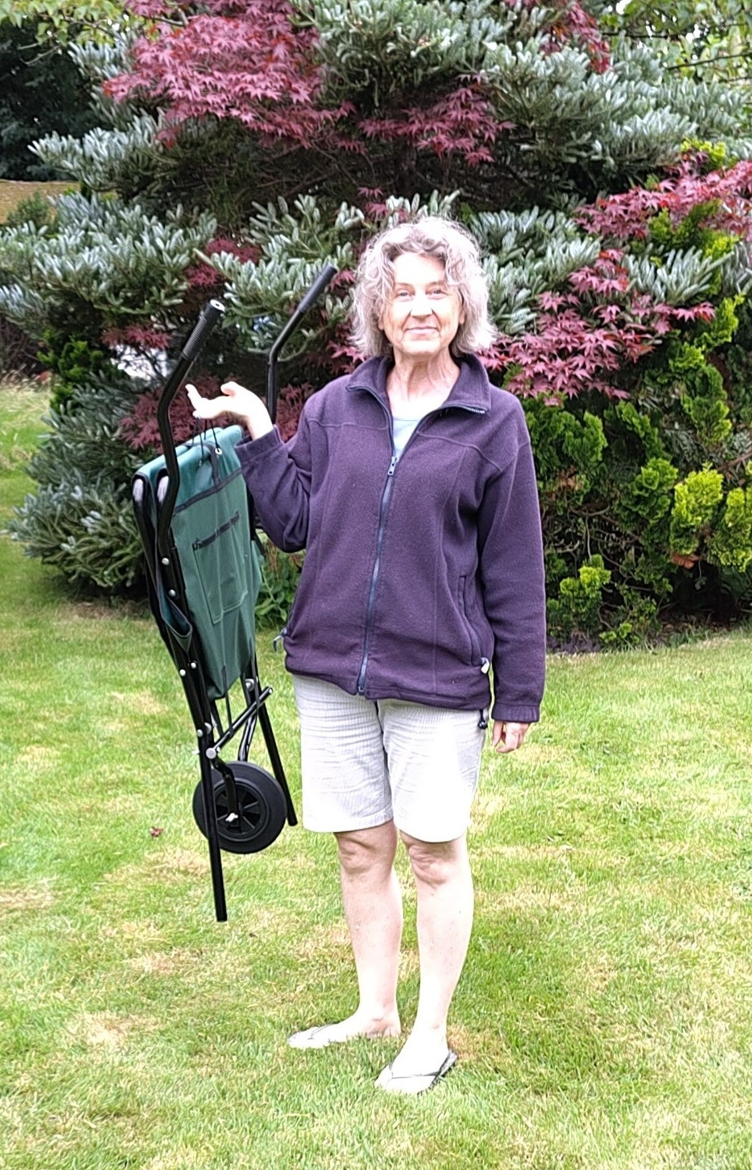
Volunteer!
Event support e.g. writing communications to advertise events, keep members updated
Technical support e.g. website/app development anyone?
Local knowledge e.g. who owns/manages land alongside the River Eden?
Fundraising for equipment e.g. water testing kits, litter pickers
Notes:
And there’s plenty to do without getting wet!
Everyone can contribute. All you need is curiosity and enthusiasm. We can provide the rest.

Slide 12
Where to start?
Join FREE! – it’s free and easy, just send us an email HelloFREESurrey@gmail.com
Support like-minded organisations and their campaigns e.g. Southeast Rivers Trust, Surrey Wildlife Trust, River Action
Check what you are putting into the River Eden Ecosystem; what goes into your drains, how you capture or slow the flow of rainwater around your home
Use less-damaging products and check for “greenwashing” e.g. use Ethical Consumer Magazine

Slide 13
Q&A – what would you like to know?

Slide 14
Thank you!
HelloFREESurrey@gmail.com

